Slide 1
Robotic Arms
AI-Based Industrial Maintenance & Process Optimization
Presented By:
01
1.Abhigyan Saini
2.Ankitha KS
3.Azmeera Raghavendar
4.Esha yadav

Slide 2
Introduction
• Robotic arms are widely used in automotive assembly, welding, machining, and manufacturing.
• Continuous operation can lead to wear, overheating, vibration, and component degradation.
• Predictive maintenance uses machine data to identify potential problems before major failures occur.
• Important telemetry parameters include temperature, vibration, voltage, current, RPM, and pressure.
• Process intelligence converts machine and maintenance data into useful operational insights.
• Machine learning analyzes telemetry patterns to identify potential protective-stop or failure conditions.
• A centralized system helps monitor machines, predictions, maintenance, incidents, inventory, and notifications.
• FactoryOps AI integrates these capabilities into a single platform for intelligent robotic-arm monitoring and proactive maintenance.

Slide 3
Problem Statement
• Unexpected robotic-arm failures can cause production downtime and operational delays.
• Traditional scheduled maintenance may not detect developing faults at the right time.
• Continuous monitoring of machine parameters is difficult with manual observation.
• Abnormal temperature and vibration may indicate developing machine problems.
• Large amounts of telemetry data can be difficult to analyze manually.
• Maintenance teams may not have early indications of potential failures.
• Machine, maintenance, incident, and inventory information may be distributed across different records.
• A centralized system is needed to monitor robotic-arm health and support proactive maintenance.
01
02
03
04

Slide 4
04
Objectives
• Develop a centralized platform for monitoring and managing robotic-arm operations.
• Collect and monitor important telemetry data from robotic-arm systems.
• Analyze parameters such as temperature, vibration, voltage, current, RPM, and pressure.
• Detect abnormal machine conditions using telemetry and operational data.
• Apply machine learning to predict potential protective-stop or failure conditions.
• Provide a dashboard for visualizing machine health and prediction results.
• Manage maintenance schedules, incidents, inventory, and operational notifications.
• Support proactive maintenance and data-driven decision-making for robotic-arm operations.
01
02
03
04
05

Slide 5
05
Proposed Solution
• FactoryOps AI provides a centralized platform for robotic-arm monitoring and maintenance management.
• The system collects machine telemetry data from different operational parameters.
• FastAPI processes requests and connects the frontend with the database and prediction services.
• Machine learning analyzes temperature and vibration data to identify potential failure conditions.
• The system displays machine health, telemetry trends, and prediction results through a dashboard.
• Maintenance records and schedules are managed to support proactive maintenance activities.
• Incidents, spare-parts inventory, and notifications are maintained within the same platform.
• The proposed system combines monitoring, prediction, and maintenance information for better operational visibility.
01
02
03
04

Slide 6
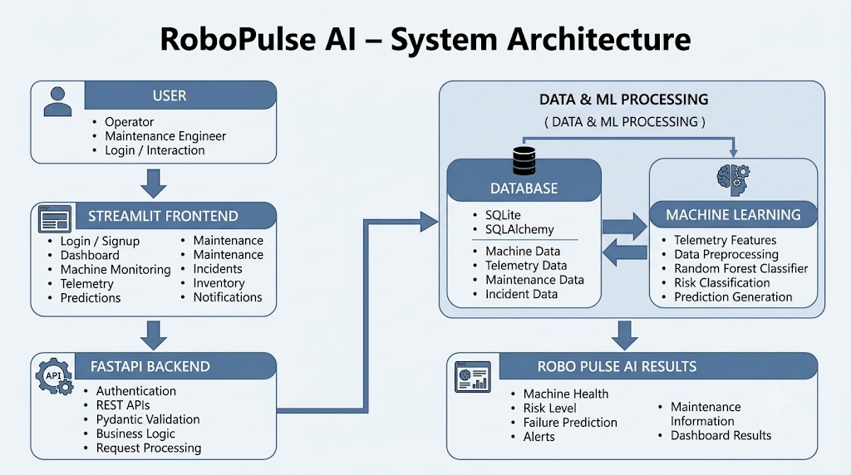
System Architecture
• User Layer – Operators and maintenance engineers interact with the system.
• Streamlit Frontend – Provides login, dashboard, machine monitoring, telemetry, predictions, and maintenance modules.
• FastAPI Backend – Handles authentication, REST APIs, request validation, and business logic.
• Database Layer – SQLite with SQLAlchemy manages machine, telemetry, maintenance, and incident data.
• ML Processing Layer – Processes telemetry data using the trained Random Forest model.
• Prediction Engine – Classifies machine conditions into Normal, Possible Failure, or High Risk.
• Results Layer – Returns machine health, predictions, alerts, and maintenance information.
01
02
04

Slide 7
07
Technology Stack
Category | Technology | Purpose
Frontend | Streamlit | Provides the interactive web dashboard
Backend | Python | Handles API requests and application logic
Programming Language | Python | Used for frontend, backend, ML, and data processing
Machine Learning | Scikit-learn | Model training and prediction
ML Model | Random forest | Used for predictive classification
Model Storage | Pickle (.pkl) | Stores and loads the trained ML model
Database | SQLite | Stores application data
Database ORM | SQLAlchemy | Provides database interaction
Data Processing | Pandas | Data loading, cleaning, and preprocessing
Development Environment | VS Code | Project development and testing

Slide 8
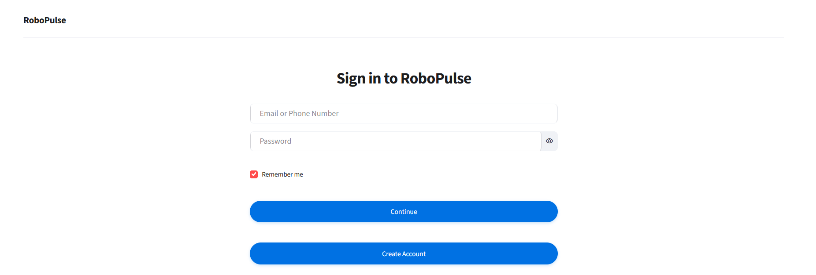
08
Frontend Implementation
• Design an interactive Landing Page to introduce RoboPulse AI.
• Implement a secure Login / Signup Page for user authentication.
• Develop a centralized Dashboard for machine health and system monitoring.
• Provide interactive Monitoring Modules for telemetry, predictions, maintenance, and incidents.

Slide 9
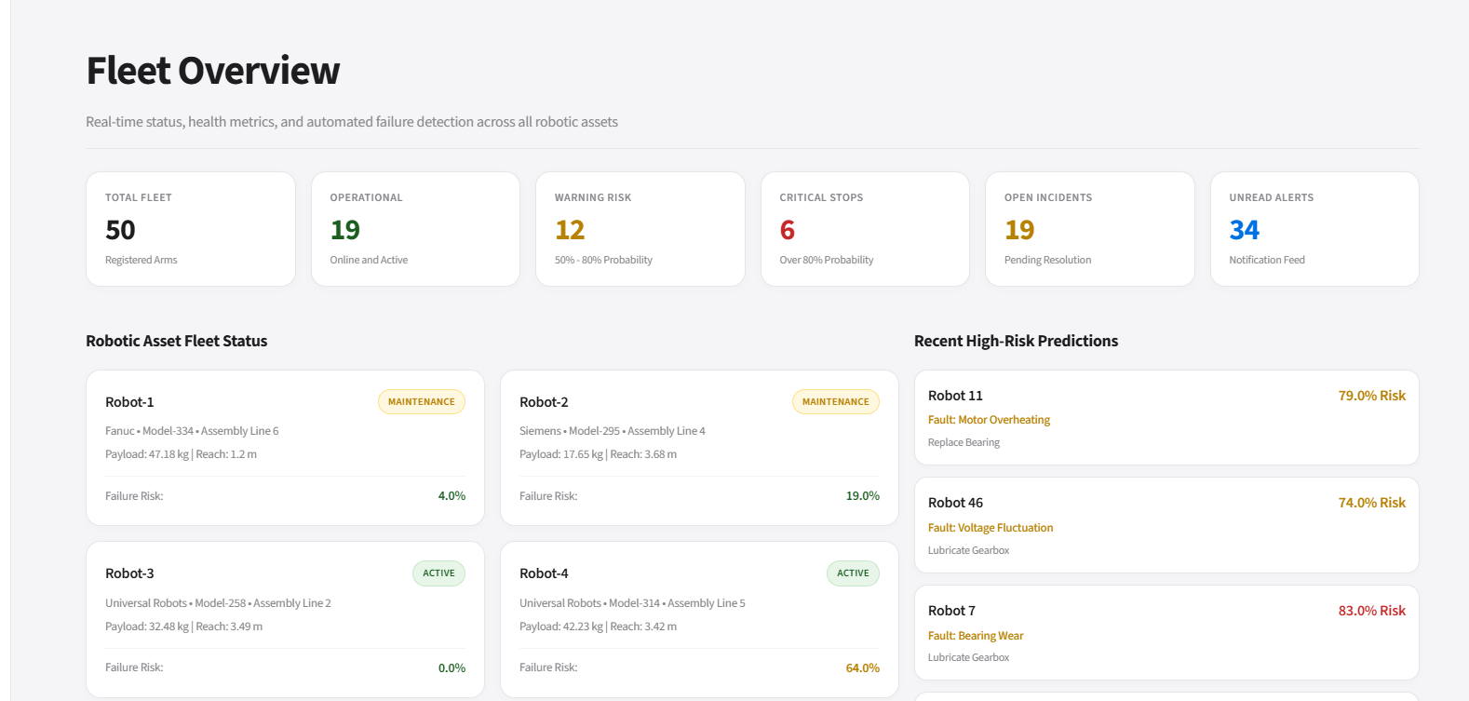
09
Dashboard & User Interface
• User Authentication – Provides secure login and signup for authorized users.
• Machine Dashboard – Displays machine health, status, and operational information.
• Telemetry Visualization – Presents temperature, vibration, pressure, RPM, and other sensor data using interactive charts.
• AI/ML Predictions – Shows machine risk levels and potential protective-stop predictions.
• Maintenance & Alerts – Tracks maintenance activities, incidents, inventory, and system notifications.

Slide 10
10
Backend & REST API
• FastAPI REST Backend – Provides the API layer that connects the Streamlit frontend with the backend services.
• API Routing – Handles endpoints for machines, telemetry, predictions, maintenance, incidents, and notifications.
• Request Validation – Uses Pydantic to validate incoming data and ensure correct request/response formats.
• Database Communication – Uses SQLAlchemy with SQLite to store and retrieve machine, telemetry, maintenance, and prediction data.
• AI/ML Integration – Processes machine telemetry through the prediction service to determine failure risk, health status, and remaining useful life.
• JSON Response – FastAPI sends processed results and prediction data back to the Streamlit frontend in JSON format.
• API Flow – Streamlit → HTTP Request → FastAPI → Business Logic → Database/ML → JSON Response → Streamlit Dashboard.

Slide 11
Database Design
• SQLite is used as the primary database for the RoboPulse AI system.
• SQLAlchemy ORM manages communication between the application and database.
• Robot/Machine data contains machine name, location, and operating status.
• Telemetry data captures temperature, vibration, pressure, voltage, current, and RPM.
• Prediction records include failure prediction, risk level, probability, and timestamp.
• Maintenance records help manage maintenance schedules, activities, and status.
• Incident records provide details about incidents, severity, descriptions, and dates.
• Centralized database access connects monitoring, prediction, maintenance, and dashboard modules.
• Data Flow: FastAPI → SQLAlchemy → SQLite → Retrieved Data → AI/ML Analysis → Streamlit Dashboard.

Slide 12
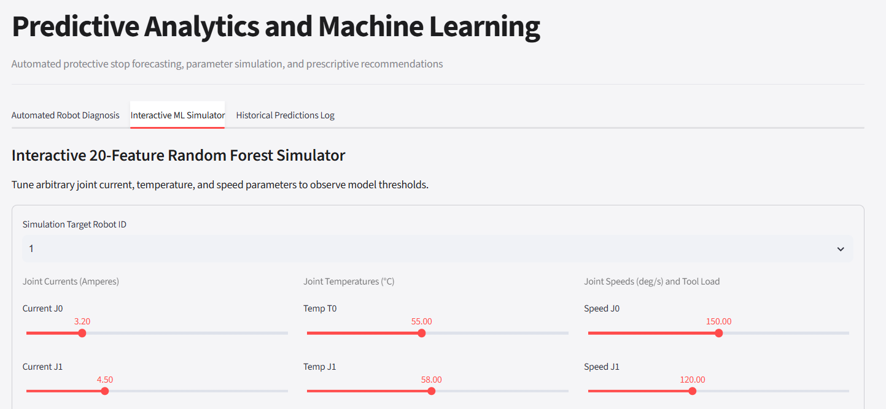
12
AI/ML Prediction System
• Scikit-learn is used to develop the machine learning model.
• Temperature and Vibration Intensity are used as key input features.
• Logistic Regression, Decision Tree, and Random Forest models were compared.
• Random Forest Classifier is used for the final prediction.
• The model learns patterns from historical machine telemetry data.
• It identifies machine conditions associated with potential protective-stop events.
• Prediction results are classified as Normal, Possible Failure, or High Risk.

Slide 13
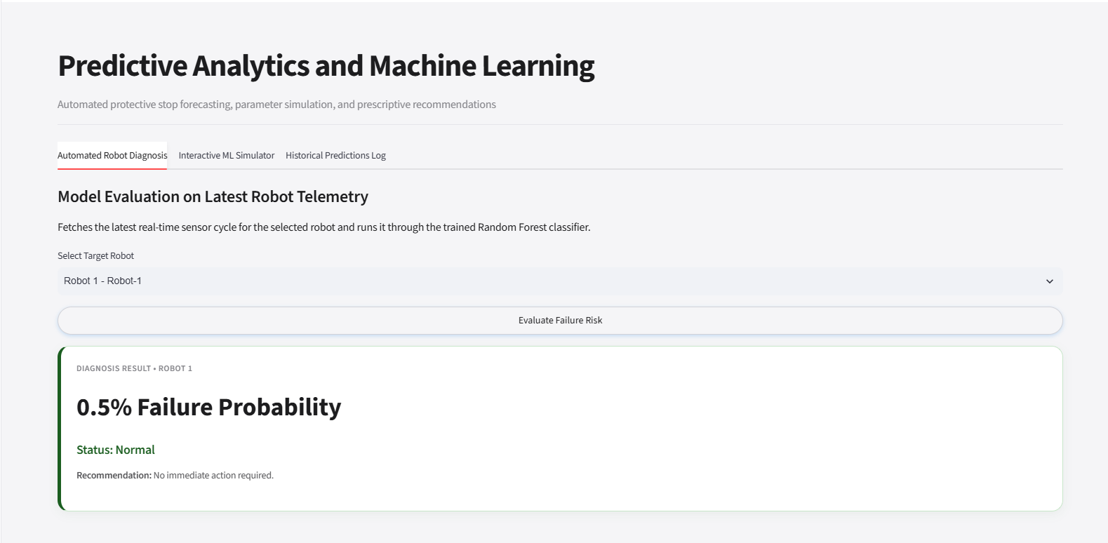
13
Prediction & Analytics Dashboard
• Machine Data – Collects temperature, vibration, and other telemetry parameters.
• Feature Extraction – Selects relevant sensor features for prediction.
• Data Preprocessing – Converts the collected values into model-ready input.
• Random Forest Model – Analyzes the input data using the trained ML model.
• Risk Classification – Determines the machine condition based on the prediction.
• Prediction Result – Generates Normal, Possible Failure, or High Risk status.
• Backend Processing – FastAPI processes the prediction request and response.
• Dashboard Display – Presents the prediction and risk information to the user.

Slide 14
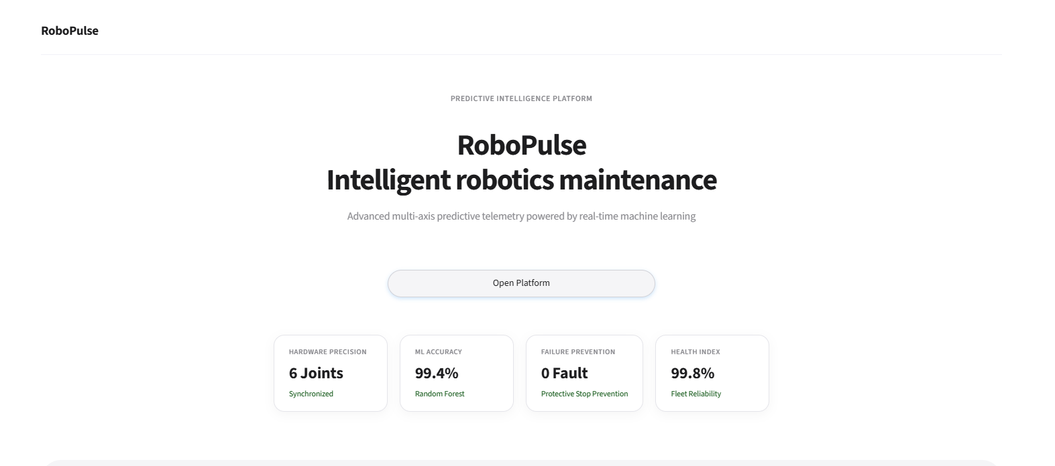
System Results
• Machine Monitoring – Successfully displays machine status, health, and operational conditions.
• Telemetry Analysis – Visualizes sensor parameters such as temperature, vibration, pressure, RPM, and humidity.
• AI-Based Prediction – Generates machine risk levels using the trained Random Forest model.
• Risk Classification – Categorizes machine conditions into Normal, Possible Failure, and High Risk.
• Maintenance Tracking – Monitors maintenance schedules and maintenance status.
• Incident Management – Records and tracks machine incidents and anomalies.
• Real-Time Dashboard – Presents machine information and analytical results in a centralized interface.
• Integrated System – Connects monitoring, telemetry, prediction, maintenance, inventory, incidents, and notifications in one platform.

Slide 15
Future Scope
• Real-Time Sensor Integration – Connect RoboPulse AI with live industrial sensors and robotic systems.
• Advanced ML Models – Improve prediction accuracy using advanced machine learning and deep learning techniques.
• Remaining Useful Life (RUL) – Estimate the remaining operational life of machine components.
• Automated Alerts – Send real-time notifications when abnormal conditions are detected.
• IoT Integration – Enable continuous data collection from connected industrial machines.
• Cloud Deployment – Deploy the system on cloud platforms for remote monitoring and scalability.
• Advanced Analytics – Add trend analysis and predictive maintenance insights for better planning.
• Digital Twin Integration – Create virtual machine models for simulation and condition monitoring.

Slide 16
Conclusion
• Developed RoboPulse AI for predictive maintenance and process intelligence.
• Integrated Streamlit, FastAPI, SQLite, SQLAlchemy, and Machine Learning into one application.
• Enables centralized robot monitoring and telemetry management.
• Provides AI-based prediction of potential protective-stop conditions.
• Supports maintenance, incident, inventory, and notification management.
• Presents machine information and prediction results through an interactive dashboard.
• Helps identify potential machine problems for timely maintenance and intervention.
• Provides a foundation for real-time, IoT-enabled, and intelligent industrial maintenance.

Slide 17


